Slide 1
APPSO Portal Reflection
Mualla Argin, Dillon Lee, Macy Drew, Thierry David, Frank Martinez
Notes:
Team dynamics: what worked and what didn’t
Key activities / processes that helped us grow professionally / personally
How effective was the agile process? What would we change?
What would we improve about the environment (e.g., hardware, software, infrastructure, working agreement, team space)?
Were stakeholders’ requirements met? Why or why not?
What did we do right? How did we celebrate?
What would we do differently (i.e., in the event of an EPIC FAIL)? Remember that it’s best to FAIL – FAST & NOW (in Sprint 1 vs. 3), instead of FAIL – SLOW or LATER (e.g., UAT in front of the customer)
How does your experience with failing help you avoid the same mistake next time?

Slide 2
Team Dynamics: What went well
Committed to improvement and to our client
Had great rapport amongst the team
Communicated & collaborated smoothly
Actively considered client feedback
Acknowledged good work
Got results!

Slide 3
Team Dynamics: What didn't go well
Inconsistent SCRUM meetings near the end of the project
Limited productivity during team collaboration days
Poor time management
Unequal division of workload

Slide 4
Key Activities: Processes that helped us grow (personally & professionally)
Usage of Jira
Version Control via GitHub
Code Reviews
Standup meetings
Despite the hiccups in consistency, standup meetings allowed us to keep us in frequent contact
Overall practice with agile development

Slide 5
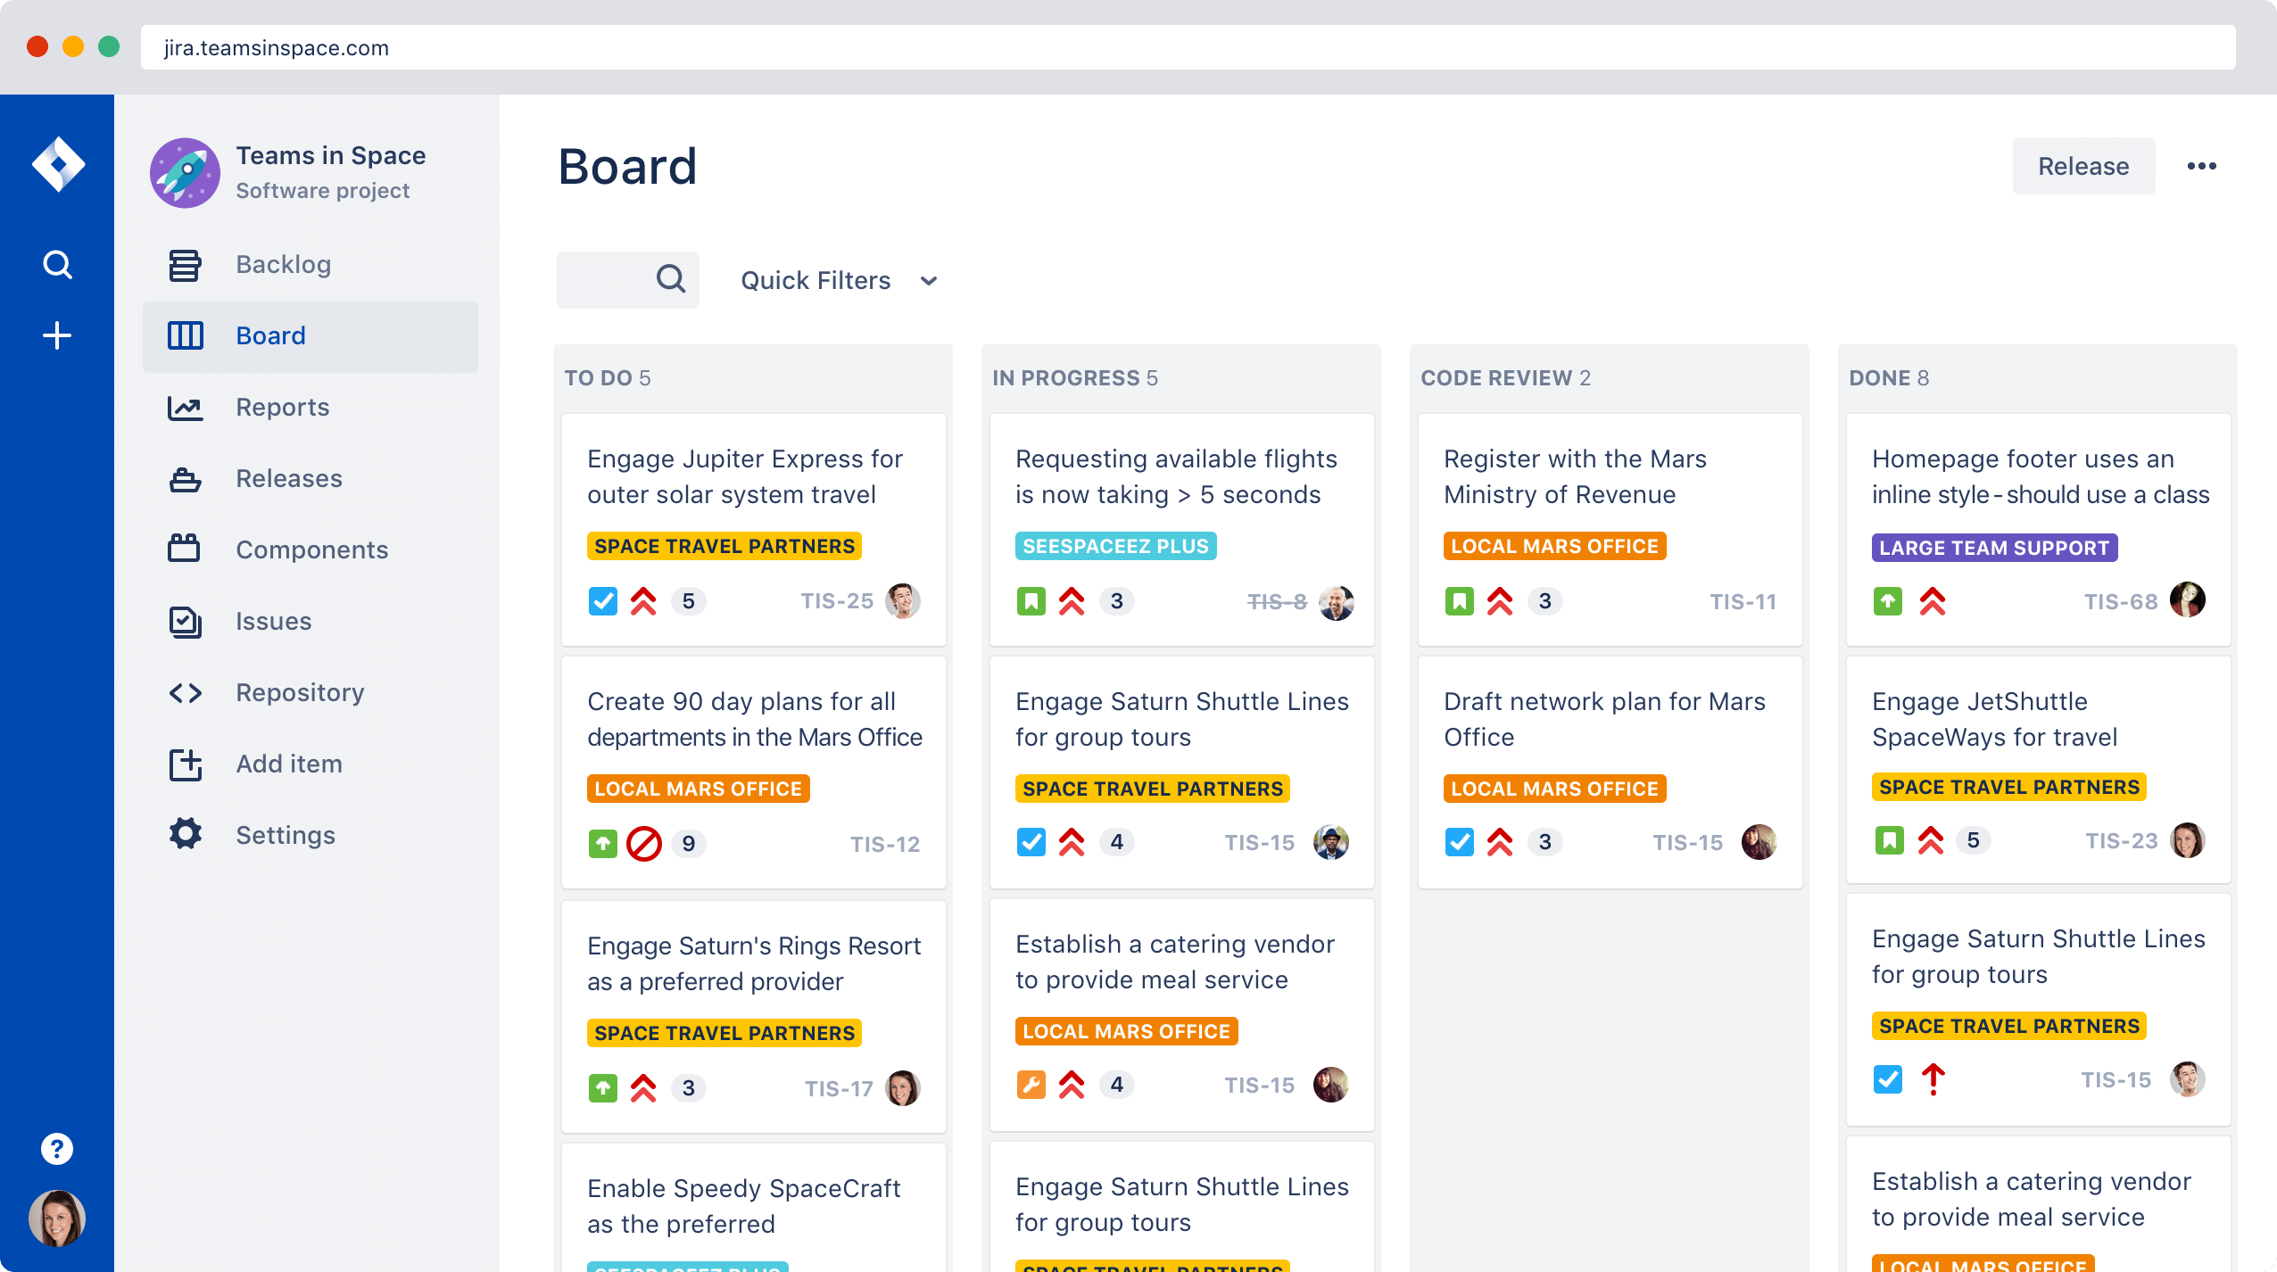
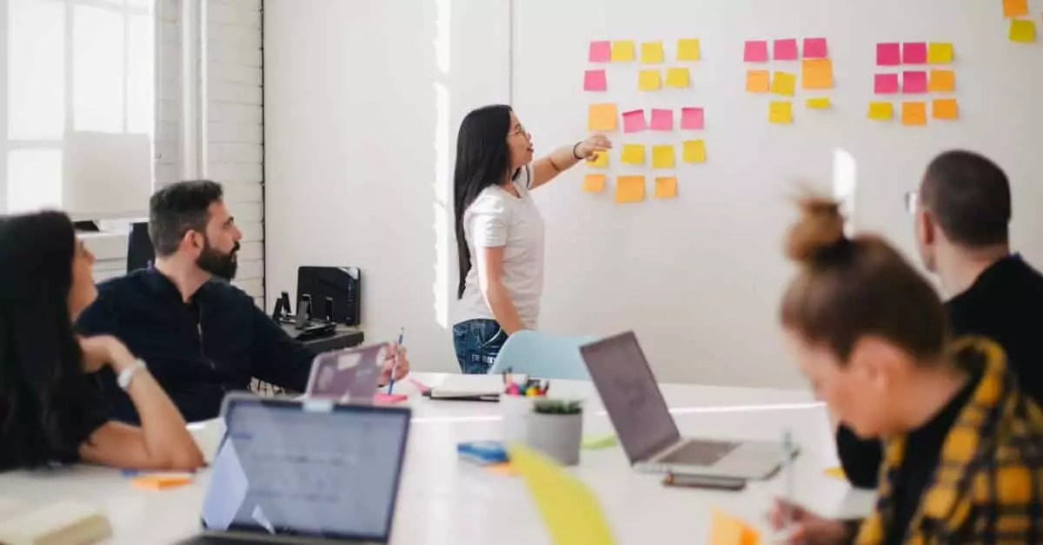
Reflection on Agile process
Scrum Meetings
Do it right!
Jira
Sprint Review

Slide 6
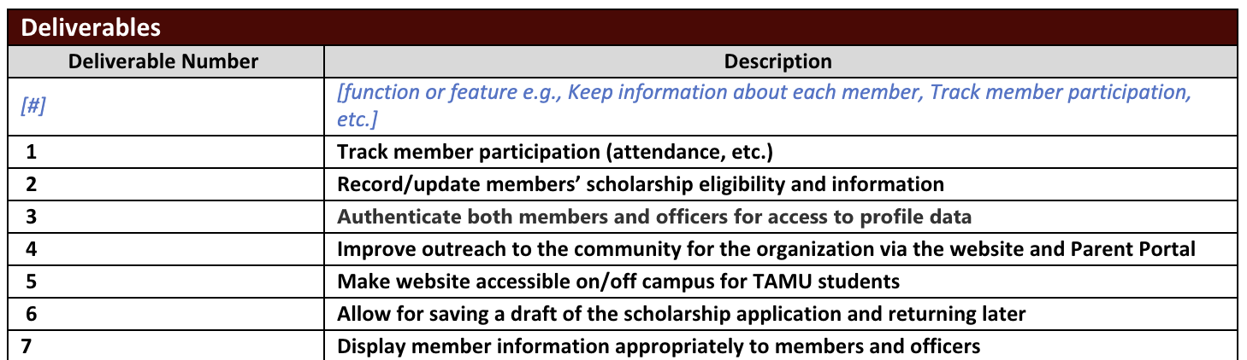
Were Stakeholder Requirements Met?
We were able to complete all the deliverables listed in our Project Scope.
These deliverables were created after initial discussion with the stakeholders regarding wants/needs for the application.

Slide 7
What could we do differently?
Utilize our team collaboration meetings more effectively.
Minimize low-collaboration tasks.
Keep each other more accountable for our assigned user stories
Be more open to asking for help

Slide 8
Acts of Service
Thierry David aka Kobe Bryant truly went above and beyond as a back-end lead throughout the project.
Frank Martinez was always available whenever Pull Request reviews and code reviews were needed asap. Made sure to deliver on user stories early or on time. Frank was also a part of the back-end team.
Dillon Lee always kept our scrum meetings upbeat and improved greatly upon the morale of the team.
Mualla Argin kept us and our customer up to date on everything we were doing.
Notes:
Thierry: Helped with GitHub Workflows setup, Heroku setup/configuration, Google OAuth implementation, User Roles, most backend-oriented user stories (a lot of functionality) in Sprint 2 and Sprint 3. He implemented most of the integration and unit tests and was always the first to fix any critical bugs and errors.

Slide 9
Thanks and Gig'Em!

